Slide 1
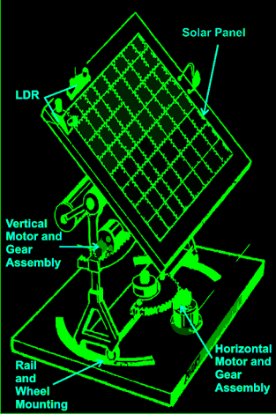
PROJECT PRESENTATION ON
ROTATORY SOLAR PANEL TRACKER
Submitted to:-
Ram Raksha Tripathi
Submitted By:-
Niharika Kesarwani
Shristi Arya
Rakesh Kumar
Mohammad Sam Yusuf

Slide 2
CONTENTS…
Introduction
Problem In Static Panel
Hardware Requirements
Hardware Components
Block Diagram
Pin Diagram of AT89S52
Power Supply

Slide 3
Continued…
Circuit Diagram
Over View Of PCB
Advantages
Any Query

Slide 4
INTRODUCTION…
The main objective of this project is to catch maximum solar energy on the solar panel.
For this purpose the solar panel is attached with the stepper motor .
Two sensors in two directions to sense the direction of maximum intensity of light. The difference between the outputs of the sensors is given to the microcontroller unit.

Slide 5
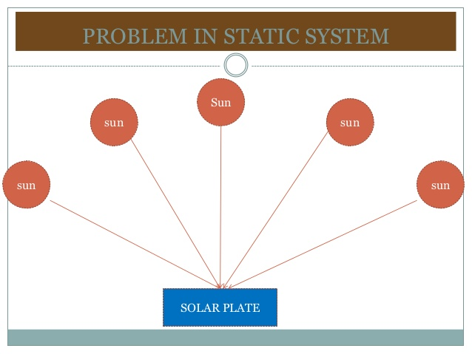
PROBLEMS IN STATIC PANEL.

Slide 6
HARDWARE REQUIREMENTS…
Transformer
Voltage Regulator(LM 7805)
Microcontroller(AT89S52)
Push BUTTON
Stepper Motor
LED
Resistors
Capacitor

Slide 7
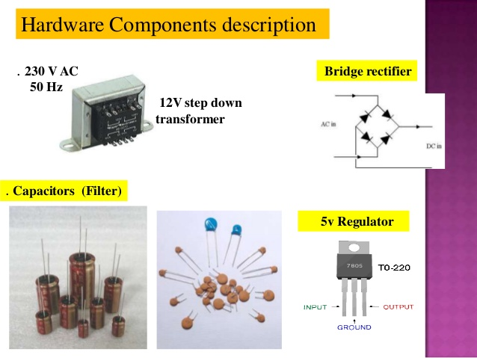

Slide 8
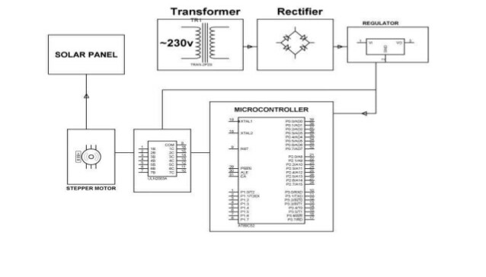
BLOCK DIAGRAM…

Slide 10
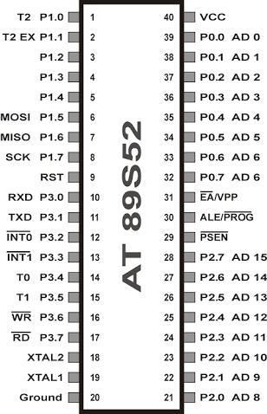
PIN DIAGRAM OF AT89S52…

Slide 11
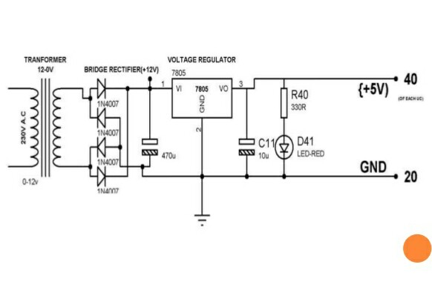
POWER SUPPLY…

Slide 12
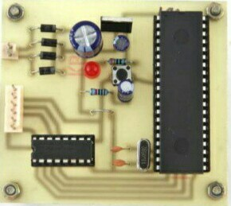
Over View of PCB…

Slide 13
ADVANTAGES……
Maximum utilization of solar energy.
Increase the efficiency of solar power plant.
No manual interpretation is required.

Slide 14
THANK YOU!

Slide 15
Any Query?

